Slide 1

CH2120 Bubble sort
Class 10
August 25, 2022

Slide 2
Pass 1
Compare
Swap
4
-2
-2
-2
-2
-2
-2
4
4
4
4
4
7
7
7
0
0
0
0
0
0
7
-9
-9
-9
-9
-9
-9
7
5
5
5
5
5
5
7
Step 1
Step 2
Step 3
Step 4
Step 5

Slide 3
Pass 2
-2
-2
-2
-2
-2
-2
4
4
0
0
0
0
0
0
4
-9
-9
-9
-9
-9
-9
4
4
4
5
5
5
5
5
5
7
7
7
7
7
7
Step 1
Step 2
Step 3
Step 4
Step 5

Slide 4
Pass 1
Pass 2
Pass 3
Pass 4
Pass 5
-2
-2
…
…
-9
4
0
…
…
-2
0
-9
…
0
0
-9
4
4
4
4
5
5
5
5
5
7
7
7
7
7
5 Steps
5 Steps
5 Steps
5 Steps
5 Steps

Slide 5
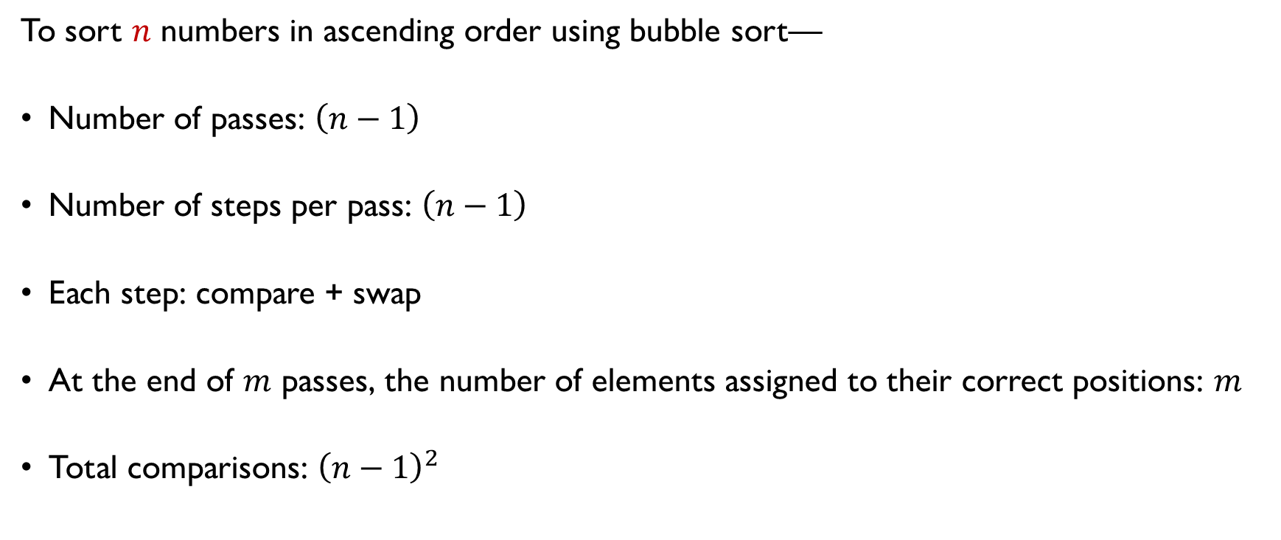
In general…
To sort $n$ numbers in ascending order using bubble sort—
Number of passes: $\left(n−1\right)$
Number of steps per pass: $\left(n−1\right)$
Each step: compare + swap
At the end of $m$ passes, the number of elements assigned to their correct positions: $m$
Total comparisons: ${\left(n−1\right)}^{2}$
?
?
?
?
?
?

Slide 6
Pass 1
Pass 2
Pass 3
Pass 4
Pass 5
…
…
…
…
-9
…
…
…
…
0
…
-2
…
-2
-2
4
4
4
4
4
5
5
5
5
5
7
7
7
7
7
5 Steps
5 Steps
5 Steps
5 Steps
5 Steps

Slide 7
In general…
To sort $n$ numbers in ascending order using bubble sort—
Number of passes: $\left(n−1\right)$
Number of steps per pass: $\left(n−1\right)$
Each step: compare + swap
At the end of $m$ passes, the number of elements assigned to their correct positions: $m$
Total comparisons: ${\left(n−1\right)}^{2}$
Efficiency?

Slide 8
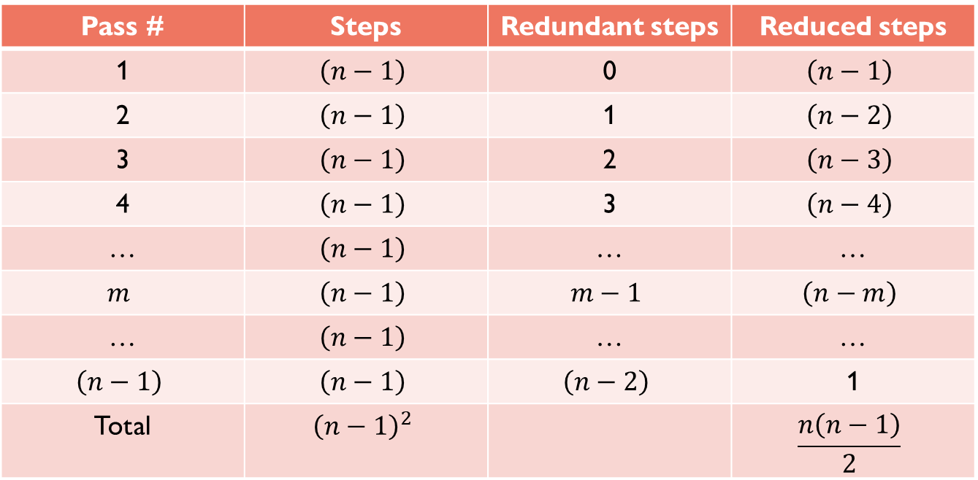
Efficiency
Pass # | Steps | Redundant steps | Reduced steps
1 | $$\left(n−1\right)$$ | 0 | $$\left(n−1\right)$$
2 | $$\left(n−1\right)$$ | 1 | $$\left(n−2\right)$$
3 | $$\left(n−1\right)$$ | 2 | $$\left(n−3\right)$$
4 | $$\left(n−1\right)$$ | 3 | $$\left(n−4\right)$$
… | $$\left(n−1\right)$$ | … | …
$$m$$ | $$\left(n−1\right)$$ | $$m−1$$ | $$\left(n−m\right)$$
… | $$\left(n−1\right)$$ | … | …
$$\left(n−1\right)$$ | $$\left(n−1\right)$$ | $$\left(n−2\right)$$ | 1
Total | $${\left(n−1\right)}^{2}$$ |  | $$\frac{n\left(n−1\right)}{2}$$
Optimization?

Slide 9
Efficiency
Pass # | Steps | Redundant steps | Reduced steps
1 | $$\left(n−1\right)$$ | 0 | $$\left(n−1\right)$$
2 | $$\left(n−1\right)$$ | 1 | $$\left(n−2\right)$$
3 | $$\left(n−1\right)$$ | 2 | $$\left(n−3\right)$$
4 | $$\left(n−1\right)$$ | 3 | $$\left(n−4\right)$$
… | $$\left(n−1\right)$$ | … | …
$$m$$ | $$\left(n−1\right)$$ | $$m−1$$ | $$\left(n−m\right)$$
… | $$\left(n−1\right)$$ | … | …
$$\left(n−1\right)$$ | $$\left(n−1\right)$$ | $$\left(n−2\right)$$ | 1
Total | $${\left(n−1\right)}^{2}$$ |  | $$\frac{n\left(n−1\right)}{2}$$

